Slide 1
R.E.Ware
Redefined and Evolved Ware
Group 3
#Sprint 3
Chris, John, Kun, Saurabh, Yang

Slide 2
New User Stories:
As an active chef, I would like my products to be durable so that I don't accidentally break it.
As a household chef, I would like to clean my products so that I can keep a tidy kitchen.
As a tech-savvy chef, I need to be able to be seamlessly connected to the contents of my R.E.Ware.
As a potential customer, I want attractive packaging for my purchase.
User Stories

Slide 3
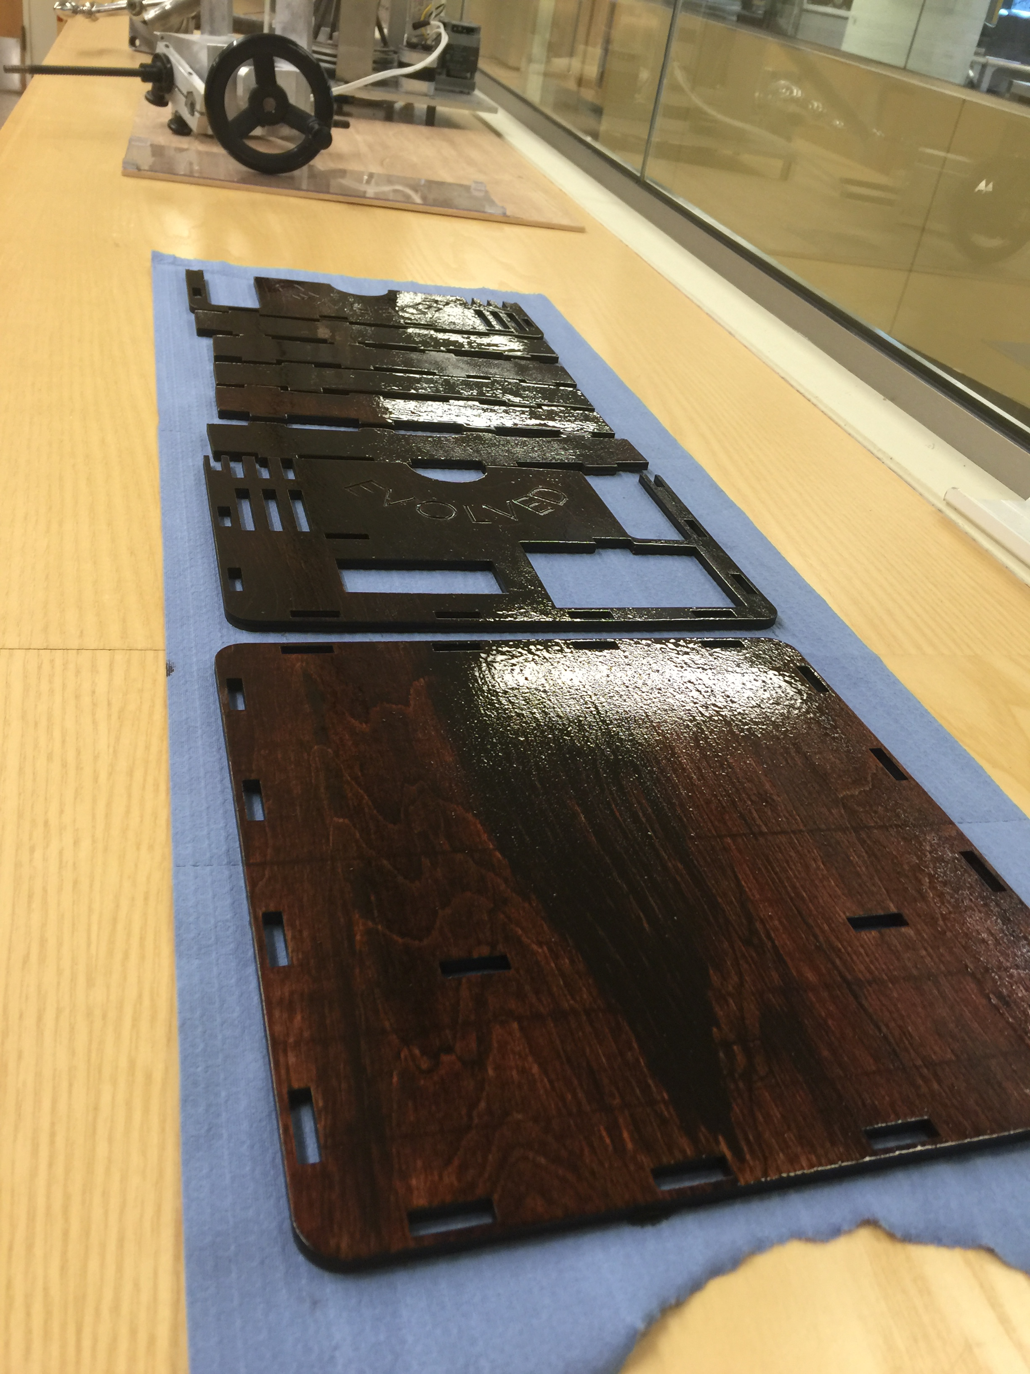
Material Selection
As an active chef, I would like my products to be durable so that I don't accidentally break it.
Heat Resistant
Shock Resistant
Aesthetically Pleasing
Durability

Slide 4
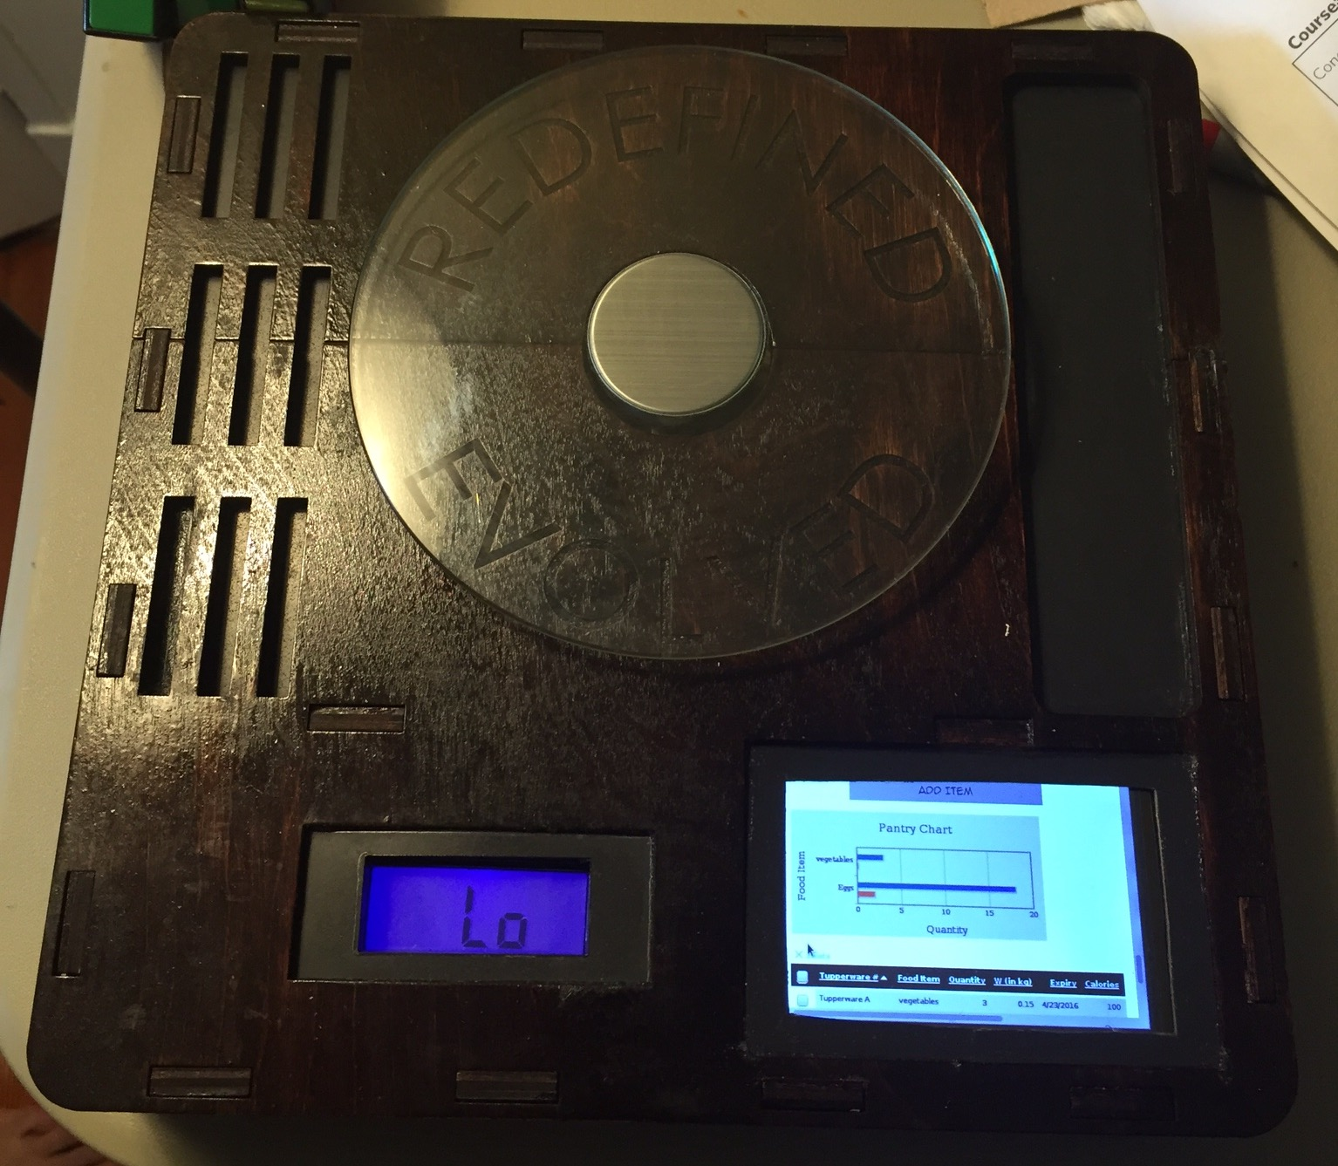
Polyurethane Coating
As a household chef, I would like to clean my products so that I can keep a tidy kitchen.
Physical Kitchen Presence
Water Resistant
Corrosion Resistant
Tidiness

Slide 5
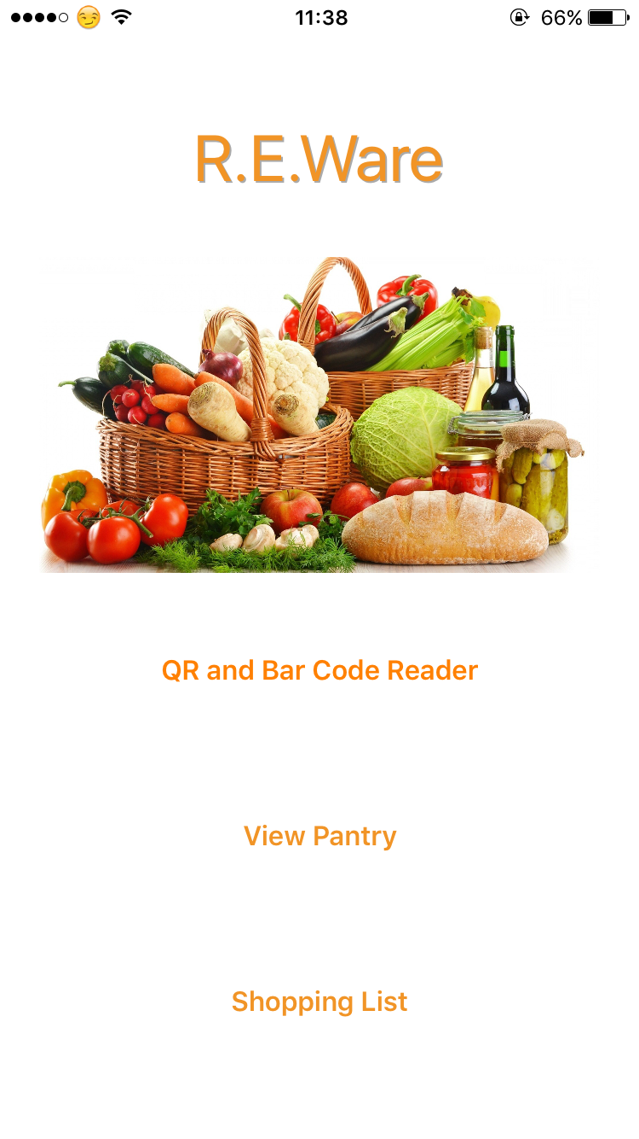
Convenience Factor
As a tech-savvy chef, I need to be able to be seamlessly connected to the contents of my R.E.Ware.
Integrated IOS Application
Detailed Descriptions
Shopping list & Banner or alert Notifications
E-mail notification of changes in contents
Economy
&
Convenience

Slide 6
Demo
iOS APP

Slide 7
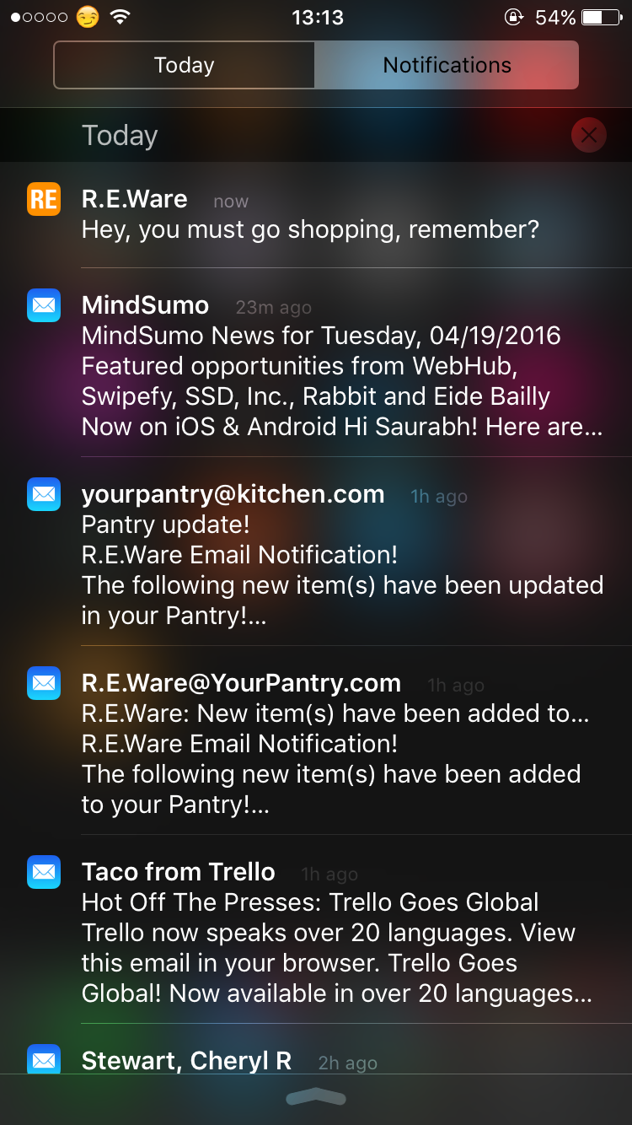
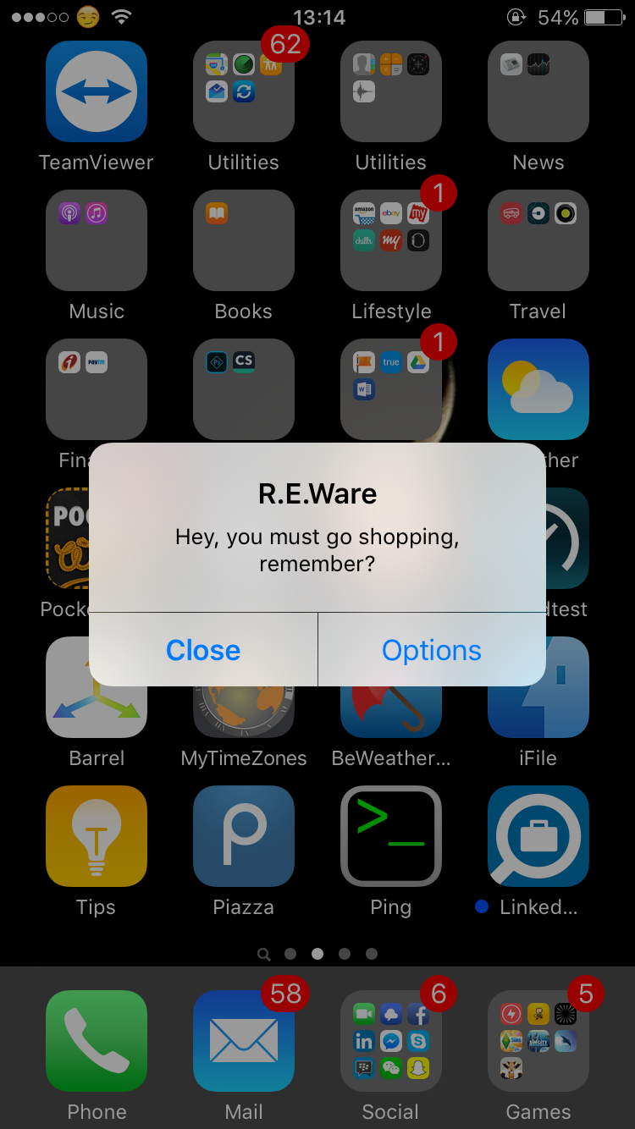
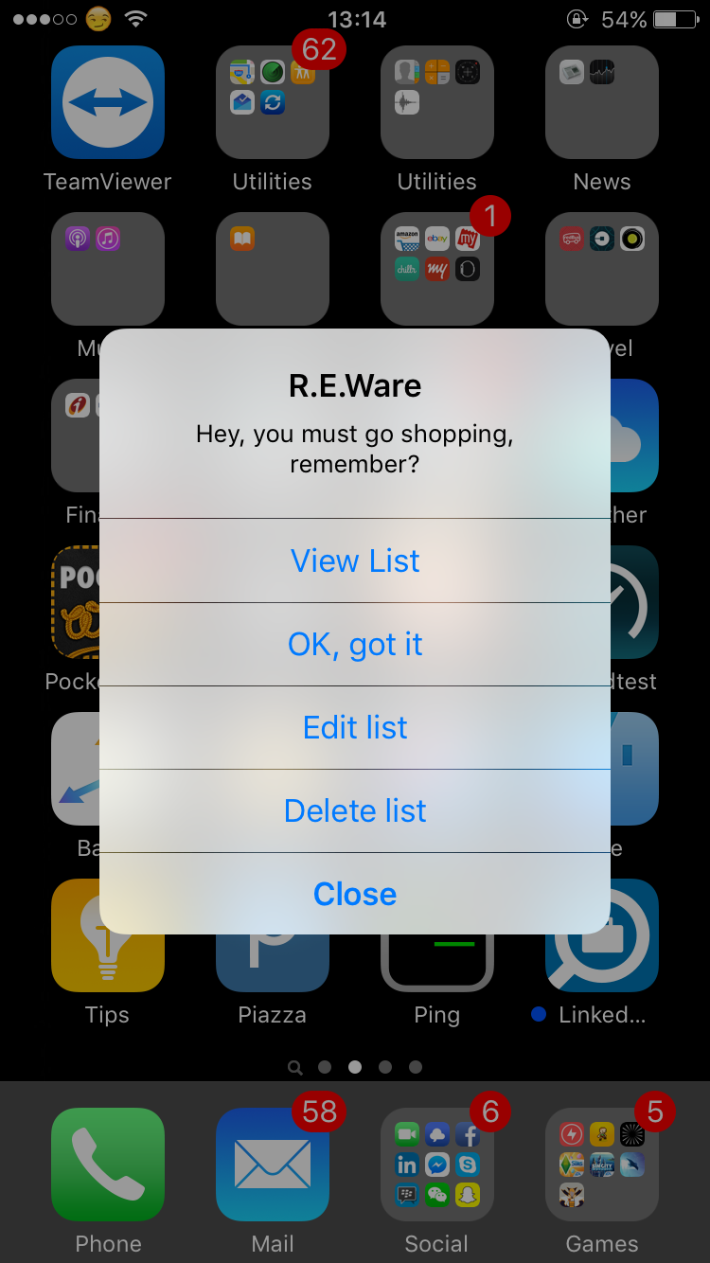
Demo
Notifications

Slide 8
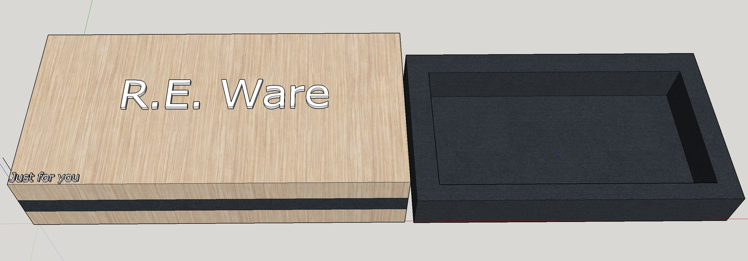
Package Demo
As a potential customer, I want attractive packaging for my purchase.
A gift package
For that perfect gift for your loved ones
Package

Slide 9
Customer
Feedback

Slide 10
Customer 1: “Great idea! Would love to see if there was a way to scan food items in.”
Occupation: 36 year old High School Teacher.
Customer 2 & 3: What do you think of having proprietary food storage containers with these capabilities built in?
Occupation: 34 year old Mother / 23 year old Graduate Student
Feedback:
Would be very convenient in all-in-one product.
Concerns over chemicals and small parts.
Customer
Feedback

Slide 11
What went well during the sprint?
Mid-sprint decisions
Came together and made hard choices.
Trust Firmly Established.
Very little oversight.
Communication on point!
Zero conflicts among group members.
What would we like to change?
Rework features of the final product.
“Product ran away from us”
Time constraints.
Semester is closing!
How can we implement that change?
Going back to the original vision of the product and making it our main focus
Sprint 3
Retrospective

Slide 12
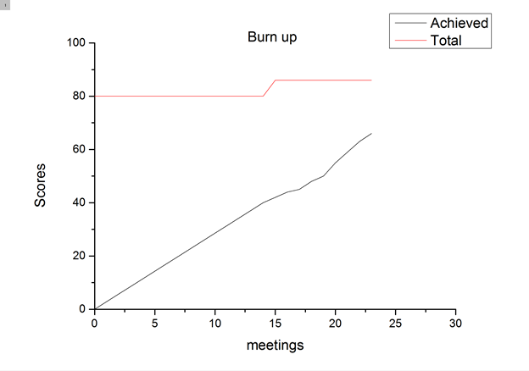
Burn Up
Chart

Slide 13
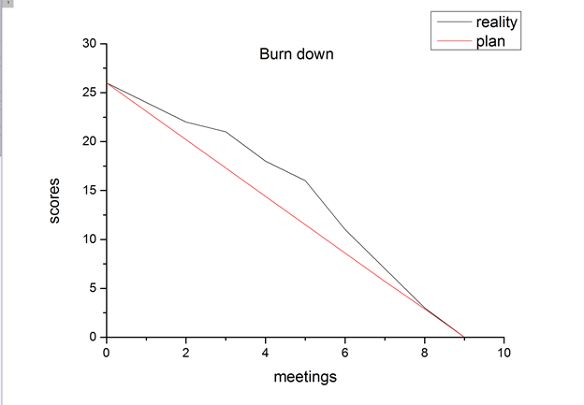
Burn Down
Chart

Slide 14
Group 3
R.E.Ware
Chris, John, Kun, Saurabh, Yang

